Slide 1
A Brief Introduction to Memory Networks
Kangqi Luo
Apr. 25, 2018

Slide 2
Contents
Background & Motivation
End-to-End MemNN: Reading Comprehension as Example
Real Example of MemNN in QA Task
Conclusion

Slide 3
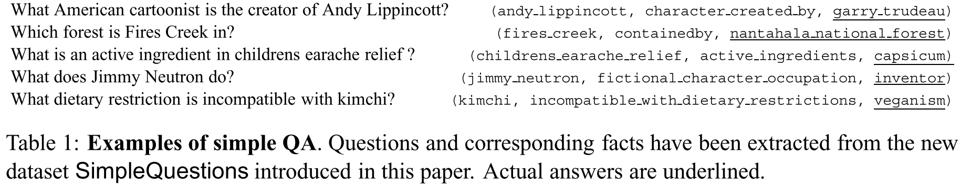
Task A: Question Answering over Knowledge Bases
Background & Motivation
Dataset: WebQ, SimpQ, CompQ …
External knowledge: <e1, r, e2> triple facts

Slide 4
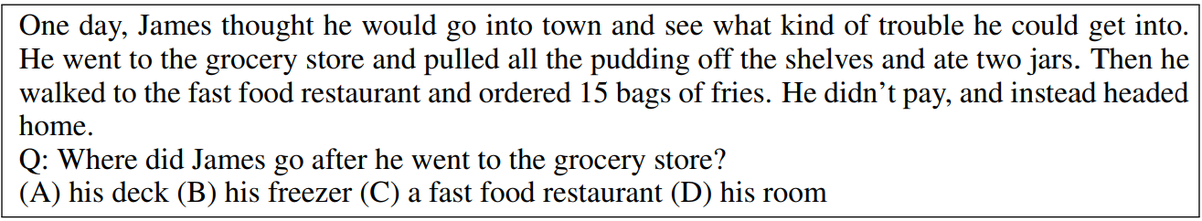
Task B: Reading Comprehension
Background & Motivation
Dataset: bAbI, MCTest, WikiQA …
Answer questions by finding clues in the passage

Slide 5

Motivation of Integration
Background & Motivation
Traditional NN framework: classification / similarity / seq2seq
How to incorporate with large external knowledge?
Documents, web corpus, knowledge bases …
y₁
y₂
y₃
o
cos
? ?
h₁
h₂
s₁
s₂
s₃
h
NN
NN
x₁
x₂
x
y
x
y

Slide 6
Papers in the Talk
[Sukhbaatar et al., 2015] End-To-End Memory Networks. NIPS 2015.
[Jain, 2016] Question Answering over Knowledge Base using Factual Memory Networks. NAACL Student Research Workshop 2016.

Slide 7
Papers in the Talk
[Sukhbaatar et al., 2015] End-To-End Memory Networks. NIPS 2015.
[Jain, 2016] Question Answering over Knowledge Base using Factual Memory Networks. NAACL Student Research Workshop 2016.

Slide 8
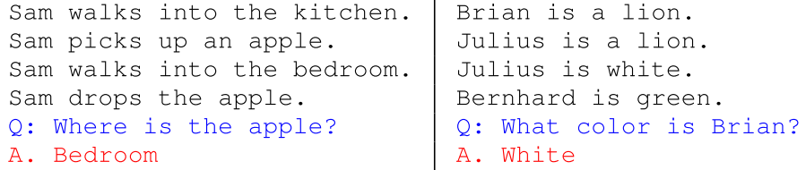
Task Definition
End-To-End Memory Networks
bAbI: statements + questions → single word as answer
20 different tasks, 1000 problems per task
at most 320 sentences per problem
Challenge: Infer the relevant supports from statements
Notes:
Simple LSTM at word level cannot handle the task well, because cannot capture the information?

Slide 9






Input Representation
End-To-End Memory Networks
Store input statements into NN (memory cells)
x_{i}: 0-1 vector of words
m_{i}: continuous BoW representation by embedding lookup
$$x_{1}$$
$$A:(d,V)$$
Sam walks into the kitchen
…, 1, …, 1, …
$$m_{1}$$
Sam picks up an apple
…, 1, …, 1, …
$$m_{2}$$
Sam walks into the bedroom
…, 1, …, 1, …
$$m_{3}$$
Sam drops the apple
…, 1, …, 1, …
……
$$V$$
Input Memory

Slide 10




Output Representation
End-To-End Memory Networks
Seeking related statements: Attention mechanism
$$A:(d,V)$$
$$m_{i}$$
……
……
……
Input Mem.
u
Where is the apple ?
$$B:(d,V)$$
Notes:
Output: what does the memory gives u

Slide 11




Output Representation
End-To-End Memory Networks
Predicted Answer
o: weighted sum of output memory
$$A:(d,V)$$
$$C:(d,V)$$
$$m_{i}$$
$$c_{i}$$
……
……
o
u'
……
……
……
……
Input Mem.
Output Mem.
u
Where is the apple ?
$$B:(d,V)$$

Slide 12
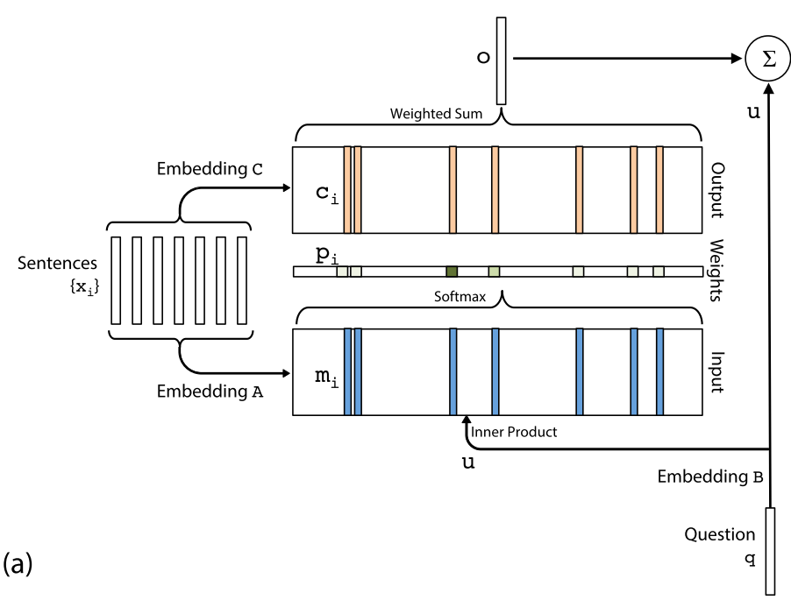
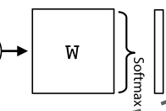
Global View of Memory Layer
End-To-End Memory Networks

Slide 13

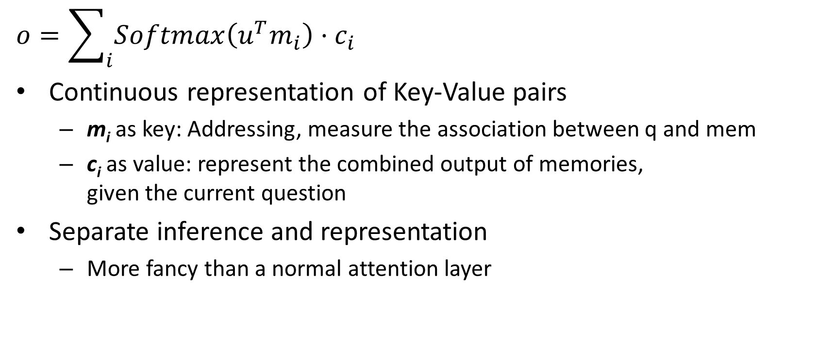
Memory Layer for Modeling Key-Value Pairs
End-To-End Memory Networks
$$o=\sum_{i}{Softmax\left(u^{T}m_{i}\right)·c_{i}}$$
Continuous representation of Key-Value pairs
m_{i} as key: Addressing, measure the association between q and mem
c_{i} as value: represent the combined output of memories, given the current question
Separate inference and representation
More fancy than a normal attention layer
Notes:
寻址，也就是对memory进行相关性评分。用key memory与输入的Question相乘之后做softmax得到一个概率分布。概率大小就表明了相关程度。Qx与Qk都是embedding模型，对输入问题和key进行编码得到其向量表示。
记忆和推理各司其职
有了相关性评分，接下来就对value memory进行加权求和即可，得到一个输出向量。

Slide 14
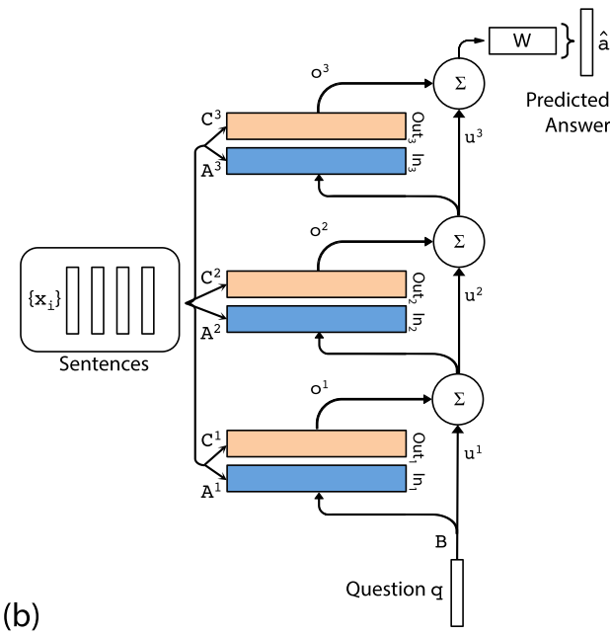

Memory Layer as Recurrent Cell
End-To-End Memory Networks
Final representation: $u^{′}=u+o$
A natural idea to stack several memory layers
$u^{k+1}=u^{k}+o^{k}$ as recurrent function
K times of parameters than before
Weight tying strategies
Adjacent: $A^{k+1}=C^{k}$
Layer-wise (RNN-like): $A^{1}=A^{2}=…=A^{k}$
Parameters over reduced
Add linear transform: $u^{k+1}={Hu}^{k}+o^{k}$

Slide 15
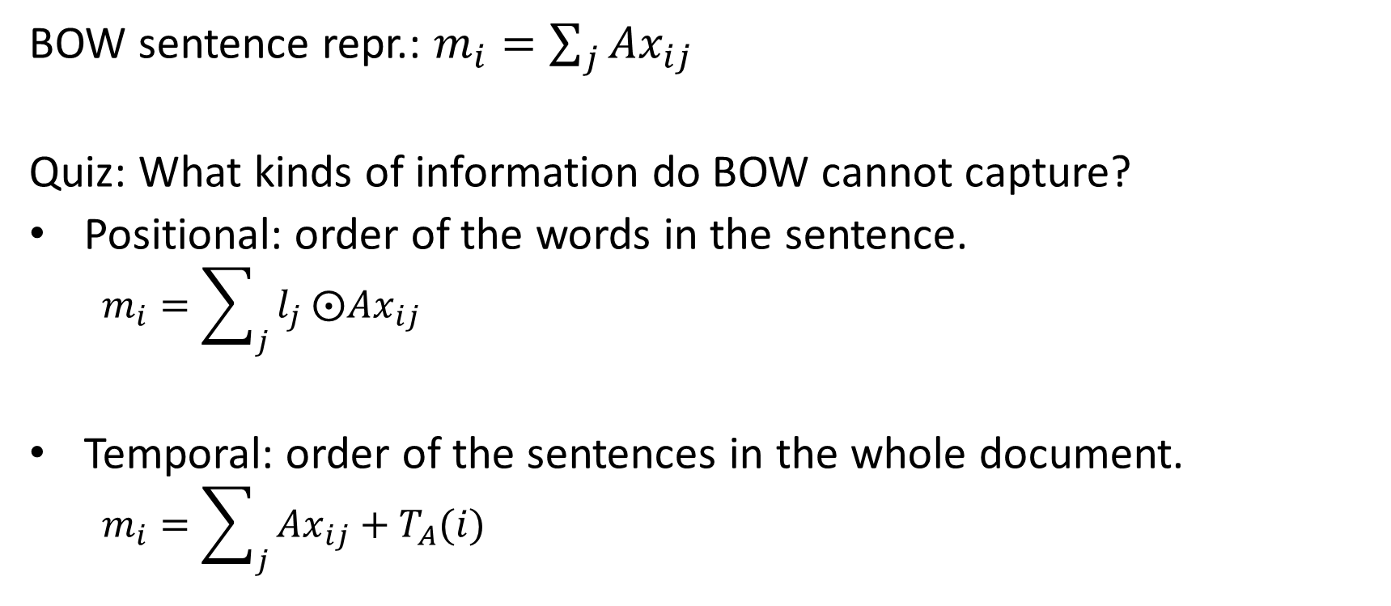
Tricks of Sentence Representation
End-To-End Memory Networks
BOW sentence repr.: $m_{i}=\sum_{j}{Ax_{ij}}$
Quiz: What kinds of information do BOW cannot capture?
Positional: order of the words in the sentence.
$$m_{i}=\sum_{j}{l_{j} ⨀Ax_{ij}}$$
Temporal: order of the sentences in the whole document.
$$m_{i}=\sum_{j}{Ax_{ij}}+T_{A}(i)$$

Slide 16
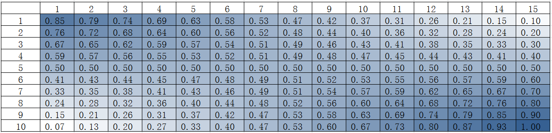
Visualization of Position Encoding
End-To-End Memory Networks
Words in a sentence = 10
Embedding dimension = 15

Slide 17
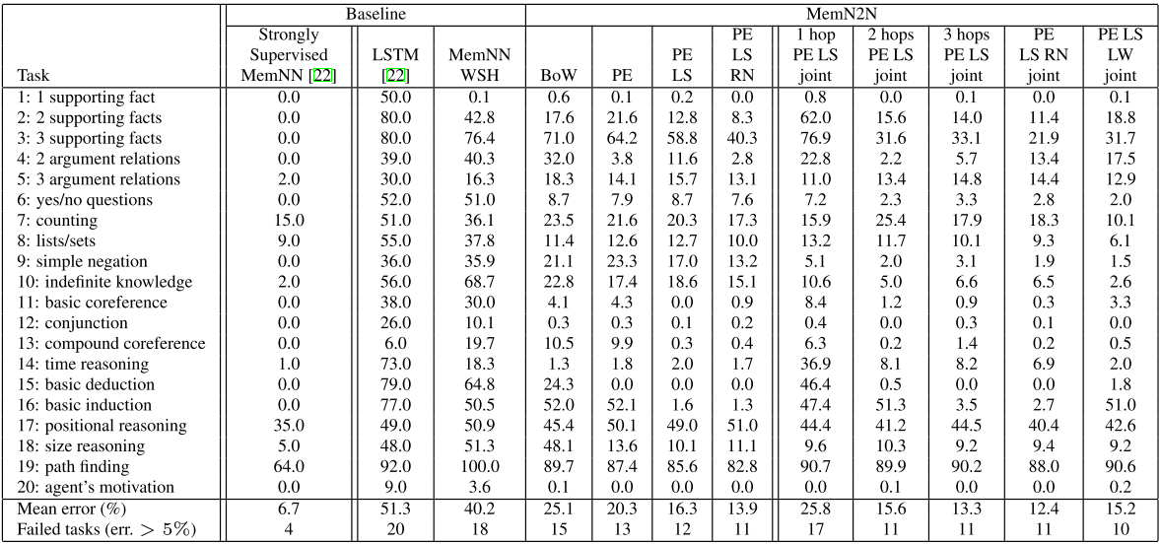
Evaluation
End-To-End Memory Networks
Notes:
1-hop: Simple attention mechanism + KV + Residual
LSTM: just 1-Tier LSTM
Table 1: Test error rates (%) on the 20 QA tasks for models using 1k training examples (mean test errors for 10k training examples are shown at the bottom). Key: BoW = bag-of-words representation; PE = position encoding representation; LS = linear start training; RN = random injection of time index noise; LW = RNN-style layer-wise weight tying (if not stated, adjacent weight tying is used); joint = joint training on all tasks (as opposed to per-task training).

Slide 18
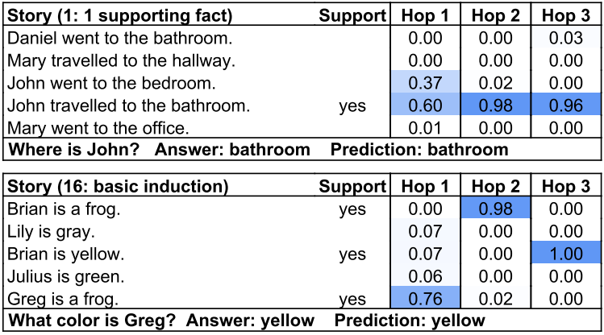
Result Display
End-To-End Memory Networks

Slide 19
Papers in the Talk
[Sukhbaatar et al., 2015] End-To-End Memory Networks. NIPS 2015.
[Jain, 2016] Question Answering over Knowledge Base using Factual Memory Networks. NAACL Student Research Workshop 2016.

Slide 20
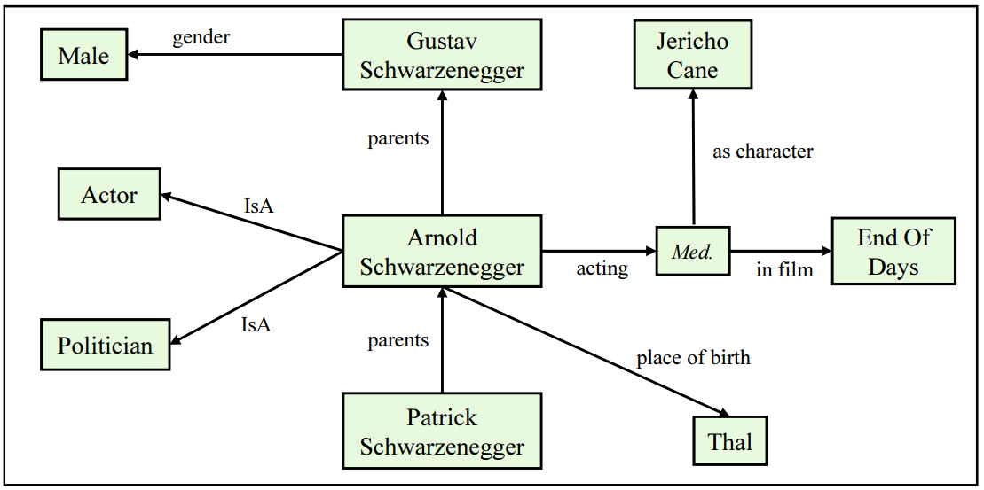
Background & Task Definition
Question Answering over Knowledge Base using Factual Memory Networks
Example of Knowledge Base

Slide 21
Task Definition
Question Answering over Knowledge Base using Factual Memory Networks
Question: “What do Jamaican people speak ?”
Target fact: <jamaica, language_spoken, jamaican_creole>
Search in a KB with billions <subj, rel, obj> triple facts

Slide 22
Framework: Similar with Previous Paper
Question Answering over Knowledge Base using Factual Memory Networks
KB Preprocess
Final Predict &
Training Objectives
Fact Selection & Dynamic Update
Position Encoding

Slide 23



KB Preprocess
Question Answering over Knowledge Base using Factual Memory Networks
Decompress the graph into triple lists
Special: “Leonardo played Jack in the Titanic”
Sibling facts: <Leonardo, character, Jack> & <Leonardo, in film, Titanic>
$$A:(d,V)$$
<Bill Gates, place of birth, Seattle>
…, 1, …, 1, …
$$m_{1}$$
<Leonardo DiCaprio, character, Jack>
…, 1, …, 1, …
$$m_{2}$$
<Beijing, contained by, China>
…, 1, …, 1, …
$$m_{3}$$
<The Great Gatsby, character, Gatsby>
…, 1, …, 1, …
……
$$s+R$$
$$V$$
Bag-Of Entity/Relation Words

Slide 24



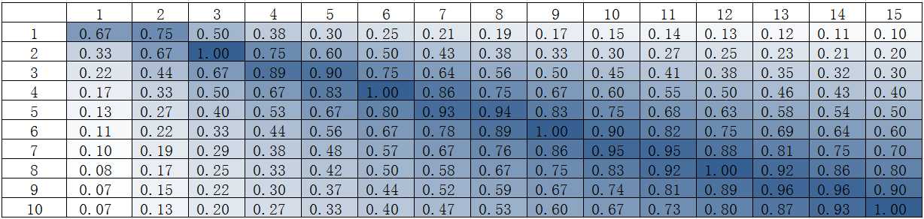
Position Encoding
Question Answering over Knowledge Base using Factual Memory Networks
For question representation only

Slide 25
Fact Selection & Dynamic Updating
Question Answering over Knowledge Base using Factual Memory Networks
Motivation: cannot involve all triples for answering one question
Initial candidate facts: entity linking on the question
Longest N-gram matching
“which character does leonardo play in the great gatsby ?”
<Bill Gates, place of birth, Seattle>
…, 1, …, 1, …
<Leonardo DiCaprio, character, Jack>
…, 1, …, 1, …
<Beijing, contained by, China>
…, 1, …, 1, …
......
…, 1, …, 1, …
<The Great Gatsby, character, Gatsby>
…, 1, …, 1, …
......
…, 1, …, 1, …

Slide 26

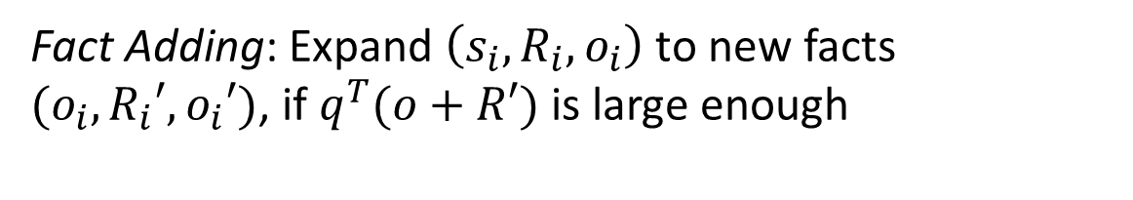

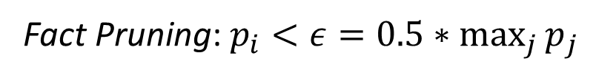

Fact Selection & Dynamic Updating
Question Answering over Knowledge Base using Factual Memory Networks
Dynamic pruning & adding facts
Used in the next hop of the memory layer
$$m_{i}$$
……
Fact Pruning: $p_{i}<ε=0.5∗\max_{j}{p_{j}}$
……
$$(s_{i},R_{i},o_{i})$$
……
Fact Adding: Expand $\left(s_{i},R_{i},o_{i}\right)$ to new facts $(o_{i},R_{i}′,o_{i}′)$, if $q^{T}(o+R′)$ is large enough
$$s+R$$
u
Input Question
$$B:(d,V)$$

Slide 27
Final Predict
Question Answering over Knowledge Base using Factual Memory Networks
Without use of the output layer
Predict the fact <s, R, o> with the biggest probability at the last hop
Notes:
We are to predict triples directly from the memory, so just find the largest P

Slide 28
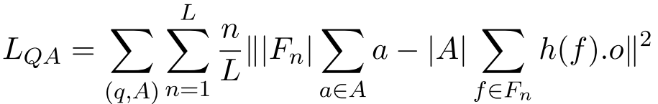
Training Objectives
Question Answering over Knowledge Base using Factual Memory Networks
Minimizing L2-distance between the gold answers and entities produced by candidate facts
Quiz: Why does the loss function considers the probability distribution h(f) not only from the last hop, but also from every hop?
Answer (of the authors): encourage the network to generate shorter paths to reach answers from the question.

Slide 29
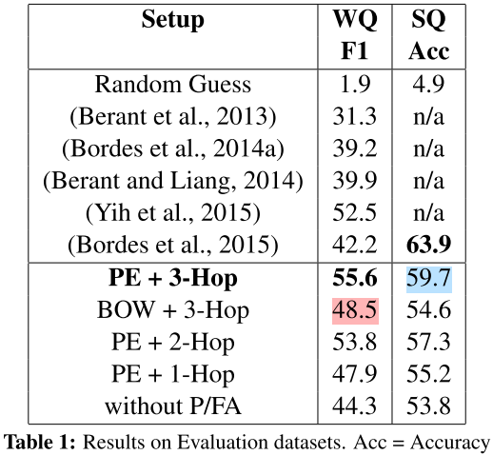
Evaluation
Question Answering over Knowledge Base using Factual Memory Networks
Notes:
PE > BOW, also difference from hops
Out of my imagination: only word embedding parameters.

Slide 30
Conclusion
Memory network is regarded as block to store external knowledge via continuous representation, and interact with other parts.
Provides differentiable approach to manipulate (read & write).
Holds more states compared to ordinary neural networks.
Interesting Properties:
Modeling Key-Value pairs: separate inference and representation
Stacking layers into RNN-like structure
Be careful with computational cost.
simpler representation, such as BoW with tricks
Active memory selection

Slide 31
thanks for your TIME!

